Slide 1

Proposal Presentation On
Software Project Lab II
By Team Twins
Project Name : IIT Library
12/06/2022
IIT Library
01

Slide 2

Supervised By
Dipok Chandra Das
Assistant Professor
Institute of Information Technology
Noakhali Science and Technology University
12/06/2022
IIT Library
02
12/06/2022

Slide 3
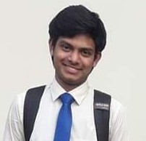
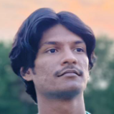

Our Team Style
ASH1825042M
1
ratna2514@student.nstu.edu.bd
facebook.com/ratnoTripuraa
Prosanto Deb
2
Ratna Kumar Tripura
Abdullah Alif
ASH1925005M
prosanto2514@student.nstu.edu.bd
ASH1925009M
facebook.com/prosantoDEB
alif2514@student.nstu.edu.bd
3
facebook.com/abdullah.alif.9210
12/06/2022
IIT Library
03

Slide 4
Table of Contents
01
02
03
04
05
06
Introduction
Motivation
Stakeholders
Features
Tools
&
Language
Challenges
12/06/2022
IIT Library
04

Slide 5
Introduction
This is a proposal presentation for Software Project Lab II. This project will be developed during the 5th semester of BSSE program. Starting from 12 June, 2022 and final project will be delivered within 08 September, 2022.
12/06/2022
IIT Library
05

Slide 6
Motivation
01
Lack of Interest in Library Books
02
Manual Library System
03
Wastage of National Resource
04
Book Cataloging requires lots of time
05
No Record of Lost Books and No one is accountable for this
06
Buy Expensive Software
07
Spend money for maintenance
08
Technical Support will not be available all time
12/06/2022
IIT Library
06

Slide 7
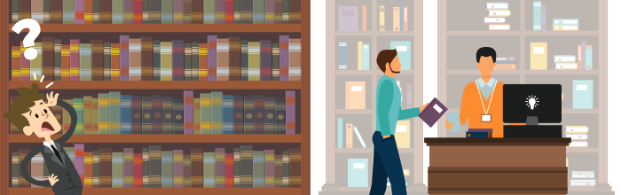
Objective
Transforming Manual to Automated Library System
12/06/2022
IIT Library
07

Slide 8
Objectives
01
Save the cost of buying a paid software or system
04
Customize and Modify Features according to requirements
02
Faster service and Remotely access
05
Always technical support will be available from the developers
03
Can use the system according to our need
06
Utilize the period of SPL II
12/06/2022
IIT Library
08

Slide 9
Stakeholders
Change Control Board
Suppliers
Individuals and teams that are part of the
organization that develops the software product – Team Twins, IIT, NSTU
Responsible for reviewing or proposing changes, approving/disapproving changes, ensuring that approved changes are implemented and validated – Faculty Members, IIT, NSTU
Acquirer
Customers who request, purchase, and/or pay for the software product – IIT NSTU
End-users who actually use the product directly or indirectly – Students, Teachers and Staff
12/06/2022
IIT Library
09

Slide 10
Features
Advanced Booking and Soft Copy of Books
Search and Cataloging Books
Fine Management
Membership Management
Data Entry by manually or Bar-coding and Scanning
12/06/2022
IIT Library
10

Slide 11




Tools and Language
Hypertext Markup Language
01
Visual Studio Code
03
05
php
PHP
02
04
Xampp
JavaScript
12/06/2022
IIT Library
11

Slide 12
Challenges
Production Level
01
02
Implementing Payment Gateway
Defining Strict Rules and Regulations
03
Solving the complexity of distributing a book between two member
04
Validation of Members
12/06/2022
IIT Library
12

Slide 13
Thank You
Asking Suggestion
Also Receiving Suggestion at
prosanto2514@student.nstu.edu.bd
alif2514@student.nstu.edu.bd
ratna2514@student.nstu.edu.bd
12/06/2022
IIT Library
13

